Slide 1
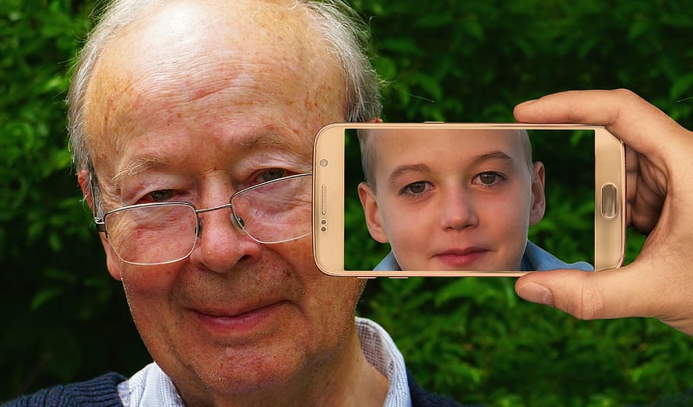
Generative Adversarial Networks
Unit 1

Slide 2
Contents
What are generative models
What are generative adversarial networks
Why we need GAN
Upsampling in GANs
How to use Up sampling layer
Transpose Convolutional Layer
GAN Training algorithm
Understanding the GAN loss function
Train GAN models in practice
Challenge for training GANs
Heuristics for training GANs
Deep convolutional GANs

Slide 3
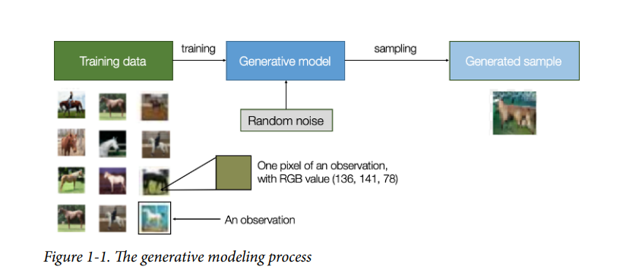
What are generative models
Generative models are a class of machine learning models designed to generate new data samples that resemble a given training dataset. These models learn the underlying patterns and structures present in the training data and then use this knowledge to generate new data points that are statistically similar to the original data.

Slide 4
Supervised Learning
A typical machine learning problem involves using a model to make a prediction, e.g. predictive modeling. This requires a training dataset that is used to train a model, comprised of multiple examples, called samples, each with input variables (X) and output class labels (y).
A model is trained by showing examples of inputs, having it predict outputs, and correcting the model to make the outputs more like the expected outputs.
In the predictive or supervised learning approach, the goal is to learn a mapping from inputs x to outputs y, given a labeled set of input-output pairs.
This correction of the model is generally referred to as a supervised form of learning, or supervised learning. It is supervised because there is a real expected outcome to which a prediction is compared

Slide 5
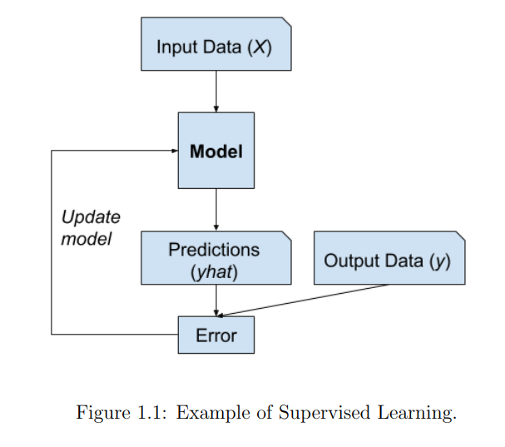
Supervised Learning
Examples of supervised learning problems include classification and regression, and examples of supervised learning algorithms include logistic regression and random forests.

Slide 6
Unsupervised learning
The model is only given the input variables (X) and the problem does not have any output variables (y). A model is constructed by extracting or summarizing the patterns in the input data. There is no correction of the model, as the model is not predicting anything.
The second main type of machine learning is the descriptive or unsupervised learning approach. Here we are only given inputs, and the goal is to find “interesting patterns” in the data.
This is a much less well-defined problem since we are not told what kinds of patterns to look for, and there is no obvious error metric to use (unlike supervised learning, where we can compare our prediction of y for a given x to the observed value)

Slide 7
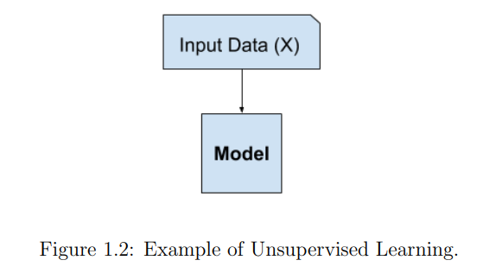
Unsupervised Learning
Examples of unsupervised learning algorithms are K-means and Generative Adversarial Networks.

Slide 8
What are generative models?
Generative models are a class of machine learning models that aim to generate new data that is similar to a given training dataset.
It is an unsupervised learning model that does not require labeled data to train. Instead, it learns the distribution of the data from a set of unlabeled examples. Once the model is trained, it can generate new data similar to the data it was trained on.
Generative models are used in various applications, including image synthesis, text generation, data augmentation, and more. They are valuable because they allow machines to create new content that resembles what they've learned from existing data.

Slide 9
Discriminator model vs Generative model
A discriminator model and a generator model are two neural networks that work together in a generative adversarial network (GAN). The discriminator model tries to distinguish between real data and fake data, while the generator model tries to generate data that is indistinguishable from real data.
The discriminator model is typically a binary classifier, which means that it outputs a value of 0 if the input data is real and a value of 1 if the input data is fake. The discriminator model is trained on a dataset of real and fake data. The real data is typically images, text, or audio that has been collected from the real world. The fake data is typically generated by the generator model.

Slide 10
Examples of Generative models
DeepDream Generator : (Image generator) https://deepdreamgenerator.com/ddream/34qirq79uwt
Introducing Make-A-Video: An AI system that generates videos from text: https://ai.meta.com/blog/generative-ai-text-to-video/
https://www.synthesia.io/demo-thank-you -Synthesia
https://www.invideo.com/ -Generate video using images, text prompts
AudioCraft: A Generative AI Tool For Audio and Music : https://about.fb.com/news/2023/08/audiocraft-generative-ai-for-music-and-audio/
Music generator : https://www.loudly.com/music/ai-music-generator

Slide 11
Types of Generative Models
Generative Adversarial Networks (GANs): GANs consist of two neural networks, the generator and the discriminator, which are trained simultaneously. The generator generates new data instances, while the discriminator tries to distinguish between real and generated data.
The two networks engage in a game where the generator aims to produce data that is indistinguishable from real data, and the discriminator aims to correctly identify whether the data is real or generated. Through this adversarial process, the generator improves over time, generating more realistic data.

Slide 12
Variational Autoencoders (VAEs): VAEs are a type of autoencoder architecture that combines both generative and probabilistic modeling. An autoencoder is a neural network that consists of an encoder and a decoder. The encoder compresses input data into a lower-dimensional latent space, and the decoder reconstructs the original data from this representation.
VAEs introduce a probabilistic approach, modeling the latent space as a probability distribution. This allows VAEs to generate new data points by sampling from the learned distribution, enabling controlled and smooth interpolation between data points.
Some other examples include Bayesian networks, Hidden Markov models etc

Slide 13
Generative Adversarial Networks
Generative Adversarial Networks (GANs) are a class of machine learning models designed for generative modeling. They were introduced by Ian Goodfellow and his colleagues in 2014. GANs consist of two neural networks, the generator and the discriminator, which are trained simultaneously through an adversarial process
The GAN model architecture involves two sub-models: a generator model for generating new examples and a discriminator model for classifying whether generated examples are real (from the domain) or fake (generated by the generator model).
Generator: Model that is used to generate new plausible examples from the problem domain.
Discriminator: Model that is used to classify examples as real (from the domain) or fake (generated).

Slide 14
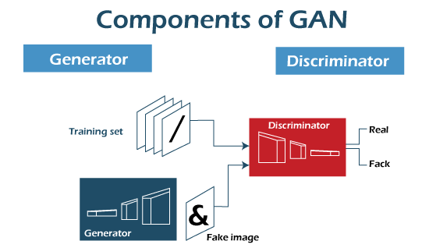

Slide 15
Generator Model
The generator model is a crucial component of Generative Adversarial Networks (GANs), which are used for generative modeling. The generator's role is to create new data samples that resemble the training data it was trained on. In the context of image generation, for example, the generator attempts to produce images that are visually realistic and share characteristics with the images in the training dataset. Here's a detailed explanation of the generator model in a GAN
The steps involved are as follows:
Architecture: The generator is a neural network that typically consists of layers of neurons organized in a specific pattern. It usually starts with a low-dimensional input, often random noise sampled from a simple distribution, such as a Gaussian distribution.

Slide 16
Generator model
This noise is gradually transformed through multiple layers into an output that represents the generated data sample. In image generation, each layer of the generator can be thought of as contributing more detailed features to the final image.
Generating Process: The generator generates data samples by mapping the random noise from the input to the desired data domain (e.g., images). This mapping process is learned during the training phase. The initial layers of the generator might capture coarse features, while subsequent layers add finer details. The goal is for the generator to learn a mapping that produces data samples that are indistinguishable from real data to human observers or to a discriminator network.

Slide 17
Generator model
Training Objective: The generator's training objective is to minimize the ability of the discriminator to distinguish between real and generated data. This is achieved by maximizing the probability that the discriminator assigns to the generated data being classified as real. In other words, the generator aims to produce data that is so convincing that the discriminator is fooled into believing it's real.
Loss Function: The loss function used to train the generator is typically derived from the adversarial nature of GANs. It involves the negative log-likelihood of the discriminator's prediction for the generated data being real. Minimizing this loss function encourages the generator to produce data that is more similar to real data.

Slide 18
Generator model
Backpropagation and Optimization: Similar to other neural network training, the generator is updated using backpropagation and optimization techniques (like stochastic gradient descent or its variants). The gradients of the loss function with respect to the generator's parameters guide its updates. As the generator's parameters are adjusted, it becomes better at producing data samples that match the underlying patterns in the training data.
Iterative Improvement: The generator improves iteratively as it engages in the adversarial training process with the discriminator. Over time, the generator learns to generate more realistic and diverse data that closely resembles the training distribution.

Slide 19
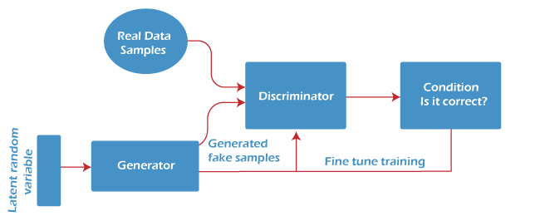
Generator model

Slide 20
Discriminator model
The discriminator model is a fundamental component of Generative Adversarial Networks (GANs), a type of machine learning model used for generative modeling. The discriminator plays a critical role in the GAN framework by evaluating and distinguishing between real and generated data samples. Its primary objective is to learn to discriminate between the two types of data.
The steps are as follows:
Architecture: The discriminator is a neural network designed as a binary classifier. It takes in data samples and assigns a probability that the input belongs to a certain class. In the context of GANs, the two classes are typically "real" and "generated." The architecture of the discriminator can vary, but it's often a deep neural network with several layers, similar to a standard neural network for classification tasks.

Slide 21
Discriminator model
Input Data: During training, the discriminator receives two types of data as input:
Real Data: Samples from the actual training dataset. For example, in image generation, these could be images from a specific dataset.
Generated Data: Data samples produced by the generator component of the GAN
Discrimination Process: The discriminator processes the input data and produces a probability score for each data sample. The score represents the discriminator's belief that the input belongs to the "real" class. In other words, the discriminator estimates how likely the input is to be real data from the training set.

Slide 22
Discriminator model
Training Objective: The discriminator's primary training objective is to accurately distinguish between real and generated data. It learns to assign high probabilities to real data and low probabilities to generated data.
Loss Function: The loss function used to train the discriminator is often a binary cross-entropy loss. This loss measures the difference between the predicted probabilities assigned by the discriminator and the actual labels (real or generated). Minimizing this loss encourages the discriminator to make accurate classifications.
Backpropagation and Optimization: Similar to training other neural networks, the discriminator is updated using backpropagation and optimization techniques (e.g., stochastic gradient descent). The gradients of the loss function with respect to the discriminator's parameters guide its updates. The discriminator becomes better at distinguishing between real and generated data as it learns from the training process.

Slide 23
Discriminator model
Adversarial Process: The discriminator and the generator are trained in an adversarial manner. While the generator's objective is to generate data that is indistinguishable from real data, the discriminator's goal is to get better at distinguishing between the two. This adversarial process creates a feedback loop where the generator continuously improves to generate more convincing data, while the discriminator aims to better differentiate real from generated data.
Training Iterations: The training of the discriminator and generator happens iteratively. The two networks improve through back-and-forth training interactions. As the discriminator becomes more skilled at identifying fake data, it provides more informative feedback to the generator, guiding it toward producing better data.

Slide 24
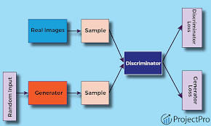

Slide 25
How to upsample GAN
Why upsampling is required for GAN?
GANs require upsampling because the generator network in a GAN takes in random noise and performs operations on it to generate new images. The output of the generator network is typically a low-resolution image, and upsampling is used to increase the resolution of the image to match the resolution of the real images that the discriminator network is trained on.
One common method used for upsampling in GANs is the transposed convolution

Slide 26
Transposed convolution operation
Transposed Convolution Overview: Transposed convolution is a way to perform the upsampling operation while also learning the upsampling filters as part of the training process. It's similar to regular convolution but in reverse: instead of shrinking the input size, it expands it. Transposed convolution layers learn how to fill in details and structure as the resolution increases.
Instead of sliding the kernel over the input and performing element-wise multiplication and summation, a transposed convolutional layer slides the input over the kernel and performs element-wise multiplication and summation. This results in an output that is larger than the input, and the size of the output can be controlled by the stride and padding parameters of the layer.
Input and Parameters: The input to the transposed convolution layer is often a low-resolution feature map or a tensor, typically generated by an earlier layer in the generator network. The transposed convolution layer has learnable parameters like filters (kernels) and biases, just like regular convolution layers.

Slide 27
Upsampling:
The transposed convolution operation increases the spatial dimensions of the input tensor. It involves inserting zeros (padding) between input elements and then applying the convolution operation.
The operation includes multiplying the filter weights with the input values and summing up the results to generate output values.
Strides and Filters:
Strides determine how much the filter moves during the convolution operation. For transposed convolution, strides are used to specify the upsampling factor.
The size of the filters affects the shape of the output. Larger filters can capture larger structures, while smaller filters capture finer details.

Slide 28
Activation Function:
Just like regular convolution layers, the output of the transposed convolution layer is usually passed through an activation function (e.g., ReLU or a variant) to introduce non-linearity.
Output and Size Adjustment:
The output of the transposed convolution layer is the upsampled feature map, which has higher spatial dimensions than the input.
Depending on the architecture, additional layers (e.g., convolutional or fully connected layers) might follow the transposed convolution to further refine the generated data.

Slide 29
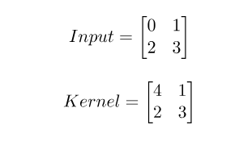
Sample example
Suppose we have a grayscale image of size 2 X 2, and we want to upsample it using a transposed convolutional layer with a kernel size of 2 x 2, a stride of 1, and zero padding (or no padding). The input image and the kernel for the transposed convolutional layer would be as follows:

Slide 30
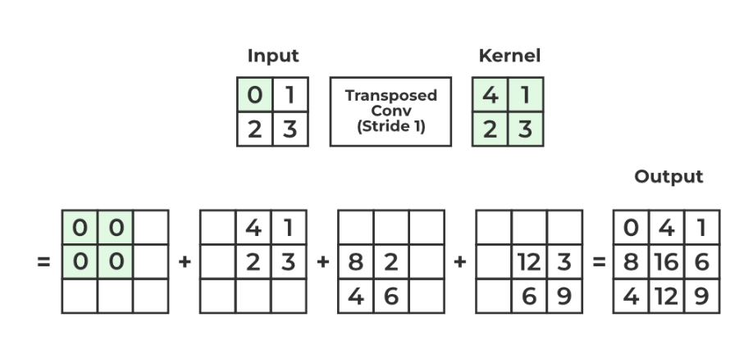
Output

Slide 31
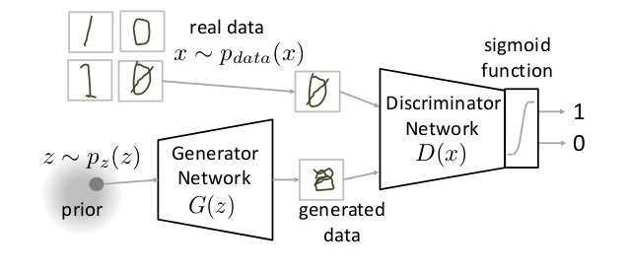
GAN Training process

Slide 32
GAN Training process
The Generator Network takes a random input and tries to generate a sample of data. In the above image, we can see that generator G(z) takes an input z from p(z), where z is a sample from probability distribution p(z).
It then generates data which is then fed into a discriminator network D(x). The task of a Discriminator Network is to take input either from the real data or from the generator and try to predict whether the input is real or generated.
It takes an input x from p_{data}(x) where p_{data}(x) is our real data distribution. D(x) then solves a binary classification problem using sigmoid function giving output in the range 0 to 1.

Slide 33
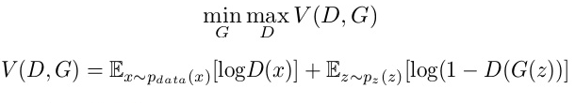
Notations
Pdata(x) -> the distribution of real data X -> sample from pdata(x) P(z) -> distribution of generator Z -> sample from p(z) G(z) -> Generator Network D(x) -> Discriminator Network
Now the training of GAN is done (as we saw above) as a fight between generator and discriminator. This can be represented mathematically as

Slide 34
GAN Training process
In our function V(D, G) the first term is entropy that the data from real distribution (pdata(x)) passes through the discriminator. The discriminator tries to maximize this to 1.
The second term is entropy that the data from random input (p(z)) passes through the generator, which then generates a fake sample which is then passed through the discriminator to identify the fakeness
In this term, discriminator tries to maximize it to 0 (i.e. the log probability that the data from generated is fake is equal to 0). So overall, the discriminator is trying to maximize our function V.
On the other hand, the task of generator is exactly opposite, i.e. it tries to minimize the function V so that the differentiation between real and fake data is bare minimum

Slide 35
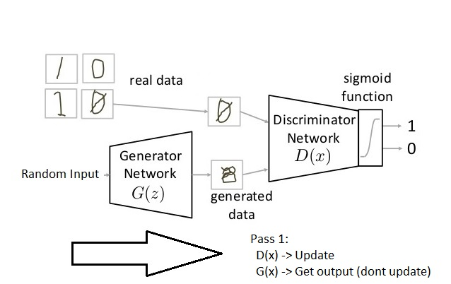
Parts of training GAN
So broadly a training phase has two main subparts and they are done sequentially
Pass 1: Train discriminator and freeze generator (freezing means setting training as false. The network does only forward pass and no backpropagation is applied)

Slide 36
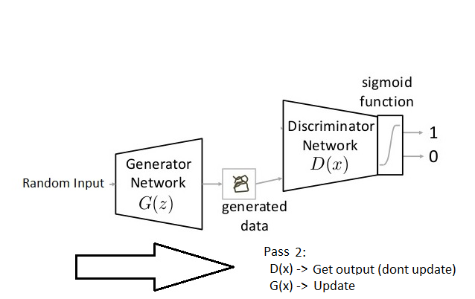
Parts of training GAN
Pass 2: Train generator and freeze discriminator

Slide 37
Steps to train GAN
Step 1: Define the problem. Do you want to generate fake images or fake text. Here you should completely define the problem and collect data for it.
Step 2: Define architecture of GAN. Define how your GAN should look like. Should both your generator and discriminator be multi layer perceptrons, or convolutional neural networks? This step will depend on what problem you are trying to solve.
Step 3: Train Discriminator on real data for n epochs. Get the data you want to generate fake on and train the discriminator to correctly predict them as real. Here value n can be any natural number between 1 and infinity.

Slide 38
Steps to train GAN
Step 4: Generate fake inputs for generator and train discriminator on fake data. Get generated data and let the discriminator correctly predict them as fake.
Step 5: Train generator with the output of discriminator. Now when the discriminator is trained, you can get its predictions and use it as an objective for training the generator. Train the generator to fool the discriminator.
Step 6: Repeat step 3 to step 5 for a few epochs.
Step 7: Check if the fake data manually if it seems legit. If it seems appropriate, stop training, else go to step 3.

Slide 39
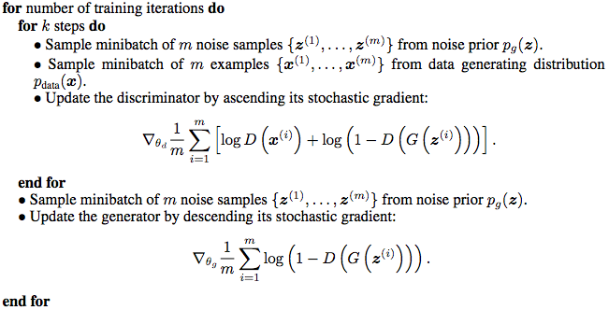
GAN Training algorithm

Slide 40
GAN LOSS FUNCTION –Min_max loss function
In GAN loss, there are two types loss values that needs to be calculated
Discriminator Loss (D_loss):
The discriminator's primary job is to distinguish between real data and data generated by the generator. The loss function for the discriminator is often a binary classification loss, such as the binary cross-entropy loss. The goal of the discriminator is to maximize this loss, making it better at distinguishing between real and generated data.
The discriminator loss is defined as follows:
D_loss = -[log(D(real_data)) + log(1 - D(generator_data))]
D(real_data) represents the discriminator's probability of correctly classifying real data as real.
D(generator_data) represents the discriminator's probability of incorrectly classifying generated data as real.
The discriminator aims to maximize this loss, which means it wants to correctly classify real data as real and generated data as fake.

Slide 41
Generator Loss (G_Loss):
The generator's objective is to produce data that is indistinguishable from real data. Therefore, the generator loss is designed to encourage the generator to produce data that the discriminator is more likely to classify as real. This loss is typically defined as:
G_loss = -log(D(generator_data))
The generator aims to minimize this loss, as a smaller value indicates that the discriminator is more likely to classify the generated data as real. In other words, the generator tries to "fool" the discriminator into thinking its output is real.
The overall training process of a GAN involves alternating between updating the discriminator and the generator by optimizing their respective loss functions:

Slide 42
Challenge of training GANs
GANs are difficult to train. The reason they are difficult to train is that both the generator model and the discriminator model are trained simultaneously in a game
This means that improvements to one model come at the expense of the other model. The goal of training two models involves finding a point of equilibrium between the two competing concerns.
It also means that every time the parameters of one of the models are updated, the nature of the optimization problem that is being solved is changed. This has the effect of creating a dynamic system
Mode of Collapse: Mode collapse occurs when the generator produces a limited variety of outputs, often focusing on a few modes of the target distribution while ignoring the others. This results in repetitive or low-quality generated samples.
Vanishing Gradients: GANs can suffer from vanishing gradients, particularly in the early stages of training. This can make it difficult for the generator to learn and improve its performance.

Slide 43
Training Instability: GAN training is inherently unstable. The discriminator and generator are in a constant adversarial struggle, and small changes in network parameters can lead to drastic changes in output. Finding the right balance between the two networks can be tricky.
Choice of Hyperparameters: Selecting appropriate hyperparameters, such as learning rates, batch sizes, and network architectures, can be challenging. Poorly chosen hyperparameters can lead to slow convergence or training failure.
Convergence Issues: GANs do not have a single, well-defined convergence criterion. In practice, GAN training is considered successful when the generator produces realistic-looking samples, but determining when to stop training can be subjective.

Slide 44
Computational Resources: Training GANs can be computationally intensive, especially for large datasets and complex network architectures. It may require access to powerful GPUs or TPUs and considerable training time.
Regularization Techniques: To mitigate some of the challenges, regularization techniques like weight clipping, gradient penalty, and spectral normalization are often used. However, applying these techniques correctly can be non-trivial.
Data Quality and Quantity: The quality and quantity of training data can significantly impact GAN training. Insufficient or low-quality data can lead to poor results, while having access to high-quality data can improve performance.

Slide 45
Deep Convolutional GANs (DCGANS)
DCGAN stands for Deep Convolutional Generative Adversarial Network. It is a type of generative adversarial network (GAN) that uses convolutional neural networks (CNNs) to generate realistic images.
The DCGAN architecture is made up of two neural networks: the generator and the discriminator. The generator is responsible for creating new images, while the discriminator is responsible for distinguishing between real and fake images.
The generator is a convolutional neural network that is trained to create images that are indistinguishable from real images. The generator takes a random noise vector as input and outputs an image. The noise vector is a vector of random numbers that is used to initialize the weights of the generator.
The discriminator is also a convolutional neural network that is trained to distinguish between real and fake images. The discriminator takes an image as input and outputs a probability that the image is real. The discriminator is trained to maximize the probability of correctly classifying real images as real and fake images as fake.

Slide 46
DCGAN
DCGAN is one of the popular and successful network design for GAN. It mainly composes of convolution layers without max pooling or fully connected layers. It uses convolutional stride and transposed convolution for the downsampling and the upsampling.
Replace all max pooling with convolutional stride
Use transposed convolution for upsampling.
Eliminate fully connected layers.
Use Batch normalization except the output layer for the generator and the input layer of the discriminator.
Use ReLU in the generator except for the output which uses tanh.
Use LeakyReLU in the discriminator.

Slide 47
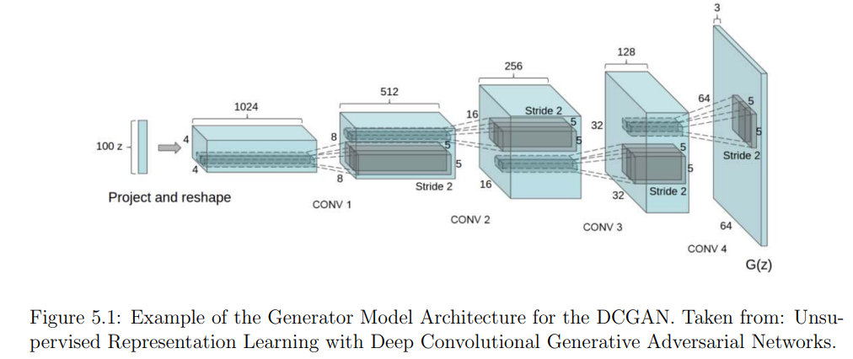

Slide 48
Differences between GAN and DCGAN
Architecture:
DCGAN: DCGAN is a specific variant of GAN designed for image generation. It uses deep convolutional neural networks (CNNs) for both the generator and discriminator. CNNs are well-suited for image-related tasks as they can capture spatial hierarchies and local patterns effectively.
Normal GAN: The term "normal GAN" typically refers to the original GAN proposed by Ian Goodfellow in 2014. It does not specify any particular architecture and can be implemented using various neural network architectures, including fully connected networks.

Slide 49
Generator and Discriminator Design:
DCGAN: In DCGAN, the generator typically consists of several transposed convolutional layers (also known as deconvolutional layers) to upsample the input noise into a higher-resolution image. The discriminator also uses convolutional layers to process and classify the images.
Normal GAN: The architecture of the generator and discriminator in a normal GAN can vary widely, and it may use fully connected layers or any other architecture that suits the specific application.

Slide 50
Batch Normalization:
DCGAN: Batch normalization is commonly used in DCGAN architectures to stabilize training and improve convergence. It helps in normalizing the activations of each layer within the network.
Normal GAN: The use of batch normalization is not a defining feature of normal GANs, although it can be added to them for improved stability.
Objective Functions:
DCGAN: DCGAN typically uses the same loss functions as normal GANs, including the generator's and discriminator's loss. These are often based on binary cross-entropy.
Normal GAN: The loss functions used in a normal GAN can vary, but the core idea is to optimize a generator to produce data that cannot be easily distinguished from real data by the discriminator.

Slide 51
Applications:
DCGAN: DCGAN is commonly used for generating high-quality images, such as faces, objects, and scenes. It has been particularly successful in image-to-image translation tasks.
Normal GAN: Normal GANs can be applied to a wide range of data types, including images, text, and more. They are not limited to images and can be used for various generative tasks.

Slide 52
THANK YOU

Slide 53
Chapter 2
Developing 1D GAN

Slide 54
Contents
Select a one-dimensional function
Discriminator model
Generator Model
Training generator model
Evaluating the performance of GAN

Slide 55
1D GAN
A 1D Generative Adversarial Network (1D GAN) is a variant of a Generative Adversarial Network (GAN) designed specifically for generating one-dimensional data. This also contains Generator and Discriminator.
In the context of a 1D GAN, the output is typically a sequence of scalar values, such as points on a 1D curve.
The generator starts with random noise and gradually refines its output over time through training to make it more similar to the real data distribution.
The discriminator aims to distinguish between real and fake data. It is trained to maximize the probability of correctly classifying real data as real and generated data as fake.

Slide 56
Training 1D GAN
GANs are comprised of both generator and discriminator models. The generator is responsible for generating new samples from the domain, and the discriminator is responsible for classifying whether samples are real or fake (generated).
Importantly, the performance of the discriminator model is used to update both the model weights of the discriminator itself and the generator model. This means that the generator never actually sees examples from the domain and is adapted based on how well the discriminator performs.
This is a complex type of model both to understand and to train.
One approach to better understand the nature of GAN models and how they can be trained is to develop a model from scratch for a very simple task.

Slide 57
A simple task that provides a good context for developing a simple GAN from scratch is a one-dimensional function.
This is because both real and generated samples can be plotted and visually inspected to get an idea of what has been learned.
A simple function also does not require sophisticated neural network models, meaning the specific generator and discriminator models used on the architecture can be easily understood.

Slide 58

Steps for 1D GAN Generation
Select a one-dimensional function
The first step is to select a one-dimensional function to model.
Something of the form: y = f(x)
Specifically, we want a function that we can easily understand and plot. This will help in both setting an expectation of what the model should be generating and in using a visual inspection of generated examples to get an idea of their quality.
We will use a simple function of x^2; that is, the function will return the square of the input. You might remember this function from high school algebra as the u-shaped function.
We can define the function in Python as follows:

Slide 59
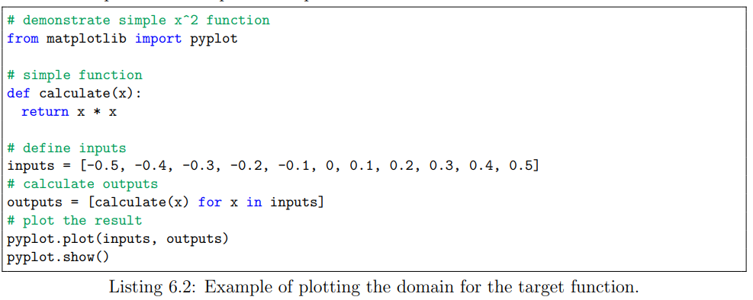
We can define the input domain as real values between -0.5 and 0.5 and calculate the output value for each input value in this linear range, then plot the results to get an idea of how inputs relate to outputs. The complete example is listed below

Slide 60
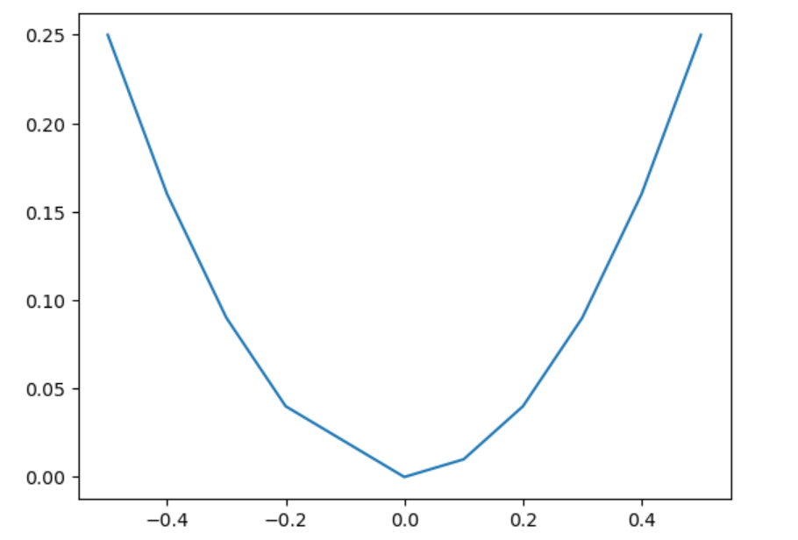
We can also generate random inputs which will be provided as an input to the discriminator as real samples

Slide 61
Define a Discriminator model
The next step is to define the discriminator model. The model must take a sample from our problem, such as a vector with two elements, and output a classification prediction as to whether the sample is real or fake. This is a binary classification problem
Inputs: Sample with two real values.
Outputs: Binary classification, likelihood the sample is real (or fake).

Slide 62
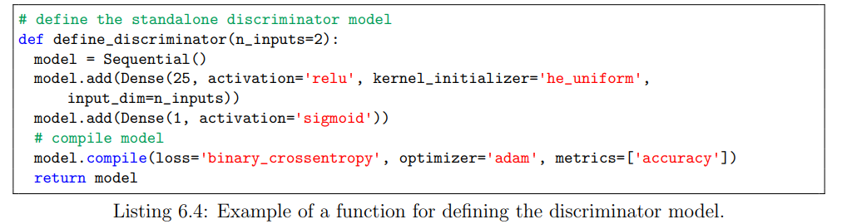

Slide 63
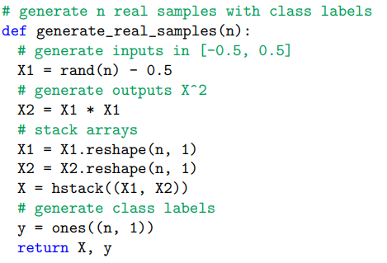
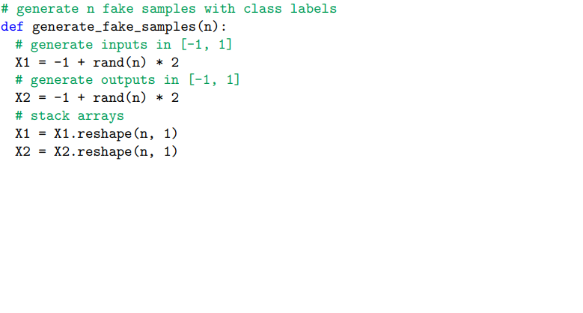
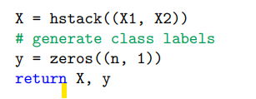
The discriminator model is trained on both real data with labels and fake data with labels

Slide 64
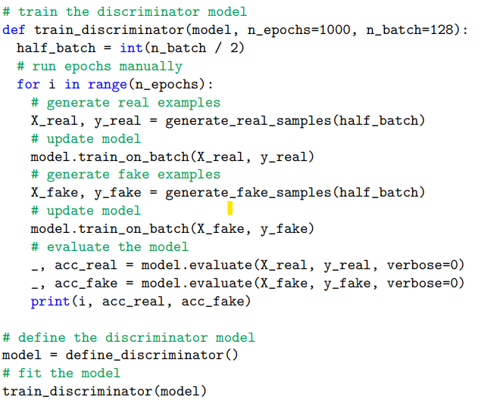
Train the discriminator model

Slide 65
Define the generator model
The next step is to define the generator model. The generator model takes as input a point from the latent space and generates a new sample, e.g. a vector with both the input and output elements of our function, e.g. x and x 2
Inputs: Point in latent space, e.g. a five-element vector of Gaussian random numbers.
Outputs: Two-element vector representing a generated sample for our function (x and x 2 ).

Slide 66
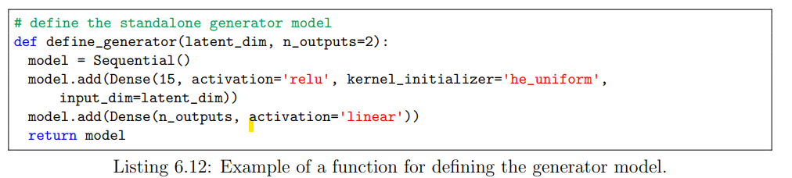
Train the generator model based on the response from the discriminator model

Slide 67
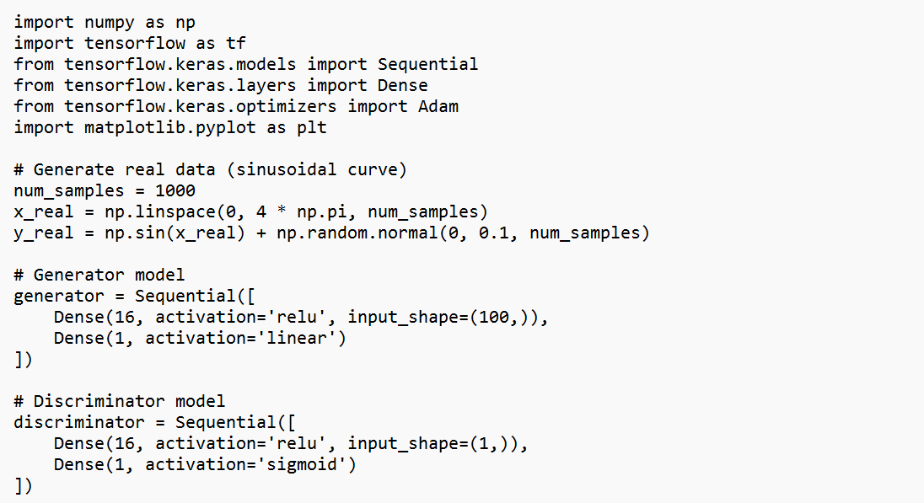
Example-1D training

Slide 68
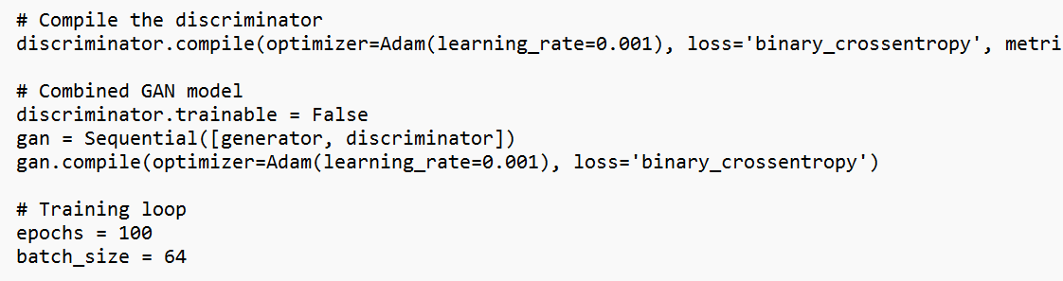

Slide 69
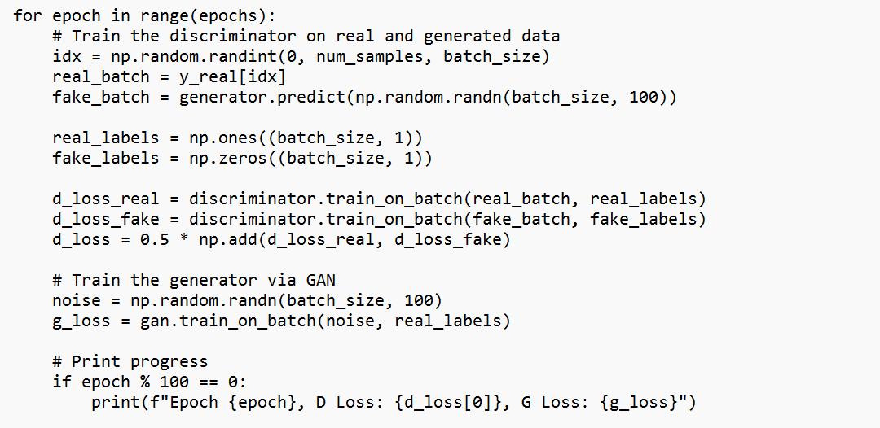

Slide 70
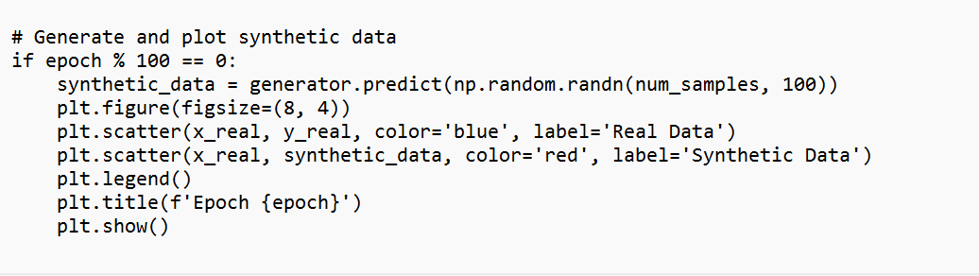

Slide 71
Evaluating GAN Performance
Evaluating the performance of Generative Adversarial Networks (GANs) can be challenging because GANs don't have a traditional loss function that directly measures how well they are doing. Instead, GANs are evaluated through various metrics and visual inspection
Visual Inspection: One simplest but most effective way to evaluate GAN performance is to visually inspect the generated samples. Are the generated images, data points, or sequences realistic and high quality? Do they resemble the real data? Visual inspection can provide valuable insights into the quality of the generated data.

Slide 72
Inception Score (IS):The Inception Score is a commonly used metric for GAN evaluation. It measures the quality and diversity of generated images. It is calculated by feeding generated images through a pre-trained InceptionV3 model and then computing the entropy of the class predictions. A higher IS indicates better image quality and diversity.
Frechet Inception Distance (FID):FID is another popular metric that evaluates GAN performance by comparing the feature statistics (mean and covariance) of real and generated data in the InceptionV3 feature space. Lower FID scores indicate better GAN performance, as it signifies that the generated data is closer to the real data distribution.

Slide 73
Frechet Inception Distance (FID): FID is another popular metric that evaluates GAN performance by comparing the feature statistics (mean and covariance) of real and generated data in the InceptionV3 feature space. Lower FID scores indicate better GAN performance, as it signifies that the generated data is closer to the real data distribution.
Precision and Recall: Precision and recall are used to evaluate the ability of the discriminator to distinguish between real and fake data. High precision means that the discriminator rarely misclassifies real data as fake, while high recall means it rarely misclassifies fake data as real. A balance between these two metrics is desirable.

Slide 74
THANK YOU

